Slide 1



AGRO
TIME
Where tech meet agriculture
Notes:
https://unsplash.com/photos/QckxruozjRg

Slide 2
Problems
Limited Access to Expert Knowledge
80% of farmers rely on outdated methods due to lack of expert advice.
Less than 10 agricultural extension workers per 10,000 farmers. (PwC, 2024)
Underdeveloped Digital & Remote Agribusiness
Market Access & Post-Harvest Losses
Smallholder farmers produce 98% of Nigeria’s food but lose 30-50% of income to middlemen. (Vanguard, 2020)
.
Agriculture contributes 22% to GDP and employs 36% of Nigerians, but digital agribusiness remains untapped. (PwC, 2024)
Skilled professionals struggle to find remote work opportunities in agriculture.
Up to 50% of harvested crops are lost, costing Nigeria ₦3.5 trillion annually. (Nairametrics, Premium Times, 2024)

Slide 3






Solution
Agribusiness Productivity & Market Access
  Real-time data, supply chain tools, and market insights to optimize operations.
  Real-time data, supply chain tools, and market insights to optimize operations.
Remote Collaboration & Networking
  Seamless tools for remote workers to connect, collaborate, and share knowledge.
Education & Skill Development
  Specialized resources and courses to empower agricultural workers.

Slide 4
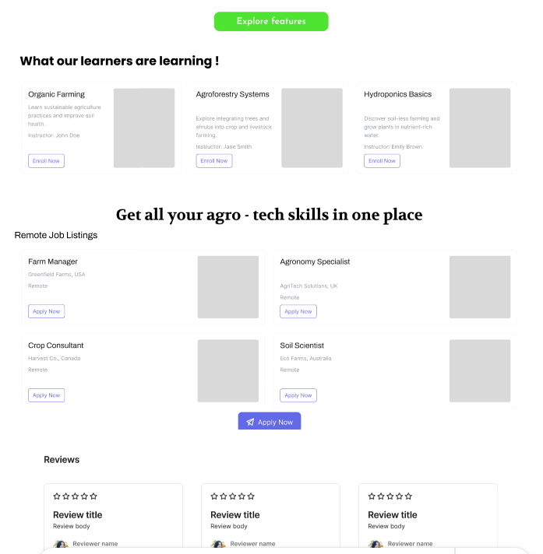
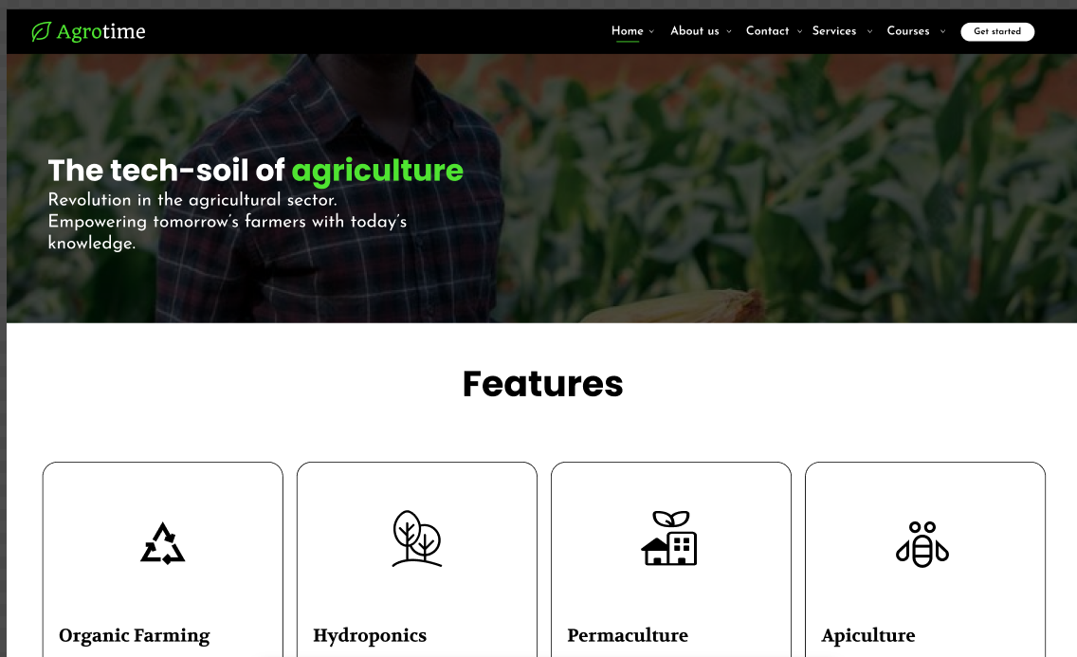
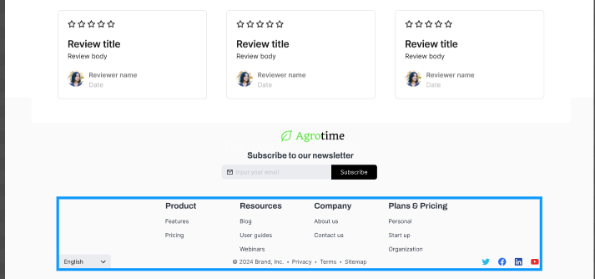
How it works

Slide 5

Market Opportunity & Business Model
Market Size
  Agriculture: $13.1 trillion in 2023, projected to reach $15.5 trillion by 2025.
  Remote Work: $111.63 billion by 2030, with 36.2 million remote workers in the U.S. by 2025.
  Online Education: $319 billion by 2025.
Business Model
  Subscription-Based: Monthly/annual fees for access to tools and resources.
  Freemium: Free basic features, paid premium content.
  Transaction Fees: Commissions on marketplace transactions.
  Advertising & Sponsorships: Revenue from industry ads and content sponsors.
  B2B Partnerships: Tailored solutions for large businesses, governments, and NGOs.

Slide 6
Competitive Advantage: How AGRO-TIME Stands Out
Unlike other agritech platforms that focus on funding, logistics, or direct farm investments, AGRO-TIME differentiates itself by prioritizing knowledge, networking, and digital agribusiness tools:
FarmCrowdy & ThriveAgric → Primarily focus on connecting farmers with investors for funding and farm sponsorships.
Fresh Direct Nigeria → Focuses on hydroponics and organic farming solutions.
✅ AGRO-TIME's Unique Value Proposition:
Education-First Approach – Structured learning on agribusiness and modern farming techniques.
Remote Work & Agribusiness Services – A marketplace where remote professionals can offer their expertise to agribusinesses.
C
Digital Agribusiness Management – Business tools to help farmers and entrepreneurs scale their ventures effectively

Slide 7
Competitive Advantage: How AGRO-TIME Stands Out
Unlike other agritech platforms that focus on funding, logistics, or direct farm investments,
AGRO-TIME differentiates itself by prioritizing knowledge, networking, and digital agribusiness tools:
FarmCrowdy & ThriveAgric → Primarily focus on connecting farmers with investors for funding and farm sponsorships.
Fresh Direct Nigeria → Focuses on hydroponics and organic farming solutions.
AGRO-TIME's Unique Value Proposition
Others
Education-First Approach – Structured learning on agribusiness and modern farming techniques.
Remote Work & Agribusiness Services – A marketplace where remote professionals can offer their expertise to agribusinesses
Remote Work & Agribusiness Services – A marketplace where remote professionals can offer their expertise to agribusinesses
Remote Work & Agribusiness Services – A marketplace where remote professionals can offer their expertise to agribusinesses.
Digital Agribusiness Management – Business tools to help farmers and entrepreneurs scale their ventures effectively

Slide 8
Our team
Ebube
Paris
Destiny
Idea guy
UI/UX Designer
Programmer

Slide 9

THANK YOU
Notes:
https://unsplash.com/photos/QckxruozjRg

